Slide 1
OSNOVA:
An AI-Powered Study Assistant Using Retrieval-Augmented Generation (RAG)
RAG
Intelligent, Context-Aware Learning from Study Materials
Himanshi Srivastava (24BKT0034)
Aditya Khandelwal (24BDS0412)

Slide 2
Introduction and Objectives
OSNOVA is an AI-powered study assistant that uses Retrieval-Augmented Generation (RAG) to answer questions from study materials, while also supporting general-purpose conversational responses.
The Problem
OSNOVA Study Assistant
Searching lengthy notes and PDFs is time-consuming
General AI answers may not be grounded in the student's notes
Students need both note-based and flexible explanations
1. Strict RAG Mode
Retrieves relevant chunks from indexed study documents
Answers grounded in retrieved context
Aims to reduce unsupported claims
If context is insufficient, states the notes lack enough information
2. Flexible RAG Mode
Uses retrieved notes as contextual guidance
Allows broader explanations and general knowledge
Helps understand concepts beyond exact note wording
May include content beyond the notes
Objectives
Make study materials easier to search and understand
Generate context-aware answers using RAG
Support strict, note-grounded and flexible learning

Slide 3
Methodology
Indexing (stages 1-5)
1. Document Collection
Subject notes and study PDFs
2. Document Processing
Text extracted from PDFs
3. Text Chunking
Text split into retrievable chunks
4. Embedding Generation
Chunks converted to vectors
5. Vector Storage
Embeddings and text stored in ChromaDB
Querying (stages 6-10)
6. Query Processing
Question converted to a retrieval query
7. Context Retrieval
Most similar chunks retrieved
8. Response Generation
Question and context passed to the language model
9. Mode-Specific Processing
Strict or Flexible RAG logic applied
10. Answer Presentation
Shown in OSNOVA UI with sources where supported
Qwen3:4B (Ollama)
Note-grounded RAG workflow
Gemini API
General conversational workflow
ChromaDB
Vector database
RAG, not fine-tuning
Retrieval supplies the knowledge

Slide 4
System Architecture
Document ingestion flow
Study PDFs
Source notes
Text Extraction
Reads PDF text
Chunking
Splits text
Embeddings
Vector per chunk
ChromaDB
Vector database
similarity search
Query flow
User Interface
Question in, mode selected
Application Backend
Routes by selected mode
Retrieval Module
Finds relevant chunks
Language Model Layer
Qwen3:4B (Ollama): note-grounded RAG
Gemini API: general conversation
Response Generation
Strict or Flexible RAG logic
Answer and source information returned to the UI
Mode-based routing: each request follows one path, so both models are not called for every question.

Slide 5
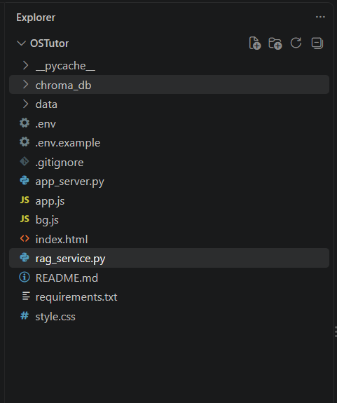
Technology Stack
Frontend: HTML, CSS and JavaScript
index.html: page structure and chat interface
style.css: layout and visual theme
app.js: handles user input and displays answers
bg.js: animated background
Backend: Python only
app_server.py: server receiving requests from the UI
rag_service.py: retrieval and response-generation logic
requirements.txt: Python dependencies
ChromaDB
Vector store (chroma_db)
Ollama
Qwen3:4B, local model
Gemini API
General conversation
Project folder structure

Slide 6
Results and Discussion
Functional Results
Discussion
Study PDFs can be ingested and indexed in ChromaDB
Questions are answered using retrieved context
Strict and Flexible RAG give different response behavior
A user interface lets students interact with the assistant
Retrieval quality depends on documents, chunking, embeddings and query
Strict RAG aligns with notes but cannot answer what they omit
Flexible RAG explains more broadly but may go beyond the notes
Latency depends on inference, retrieval and processing
Testing (qualitative functional checks)
Observed Limitations of the Current Implementation
Test Case | Expected Behavior | Observed Result
Relevant question | Answer from retrieved notes | To be recorded
Question absent from notes | Strict RAG states notes are insufficient | To be recorded
Strict RAG response | Grounded in notes | Grounded; slower; sometimes indirect
Flexible RAG response | Broader explanation | To be recorded
Document ingestion | PDF indexed in ChromaDB | To be recorded
Limitation | Observed Issue | Possible Improvement
Response latency | Strict RAG takes longer: retrieval plus local Ollama inference; varies with model, hardware and query | Optimize retrieval, reduce unnecessary context, improve inference efficiency
Answer directness | The local model sometimes gives indirect or less precise answers from retrieved context | Improve prompting, refine context selection, test alternative models or settings
Retrieval does not guarantee every answer is direct or accurate. Formal quantitative evaluation (latency, relevance, groundedness) remains future work.

Slide 7
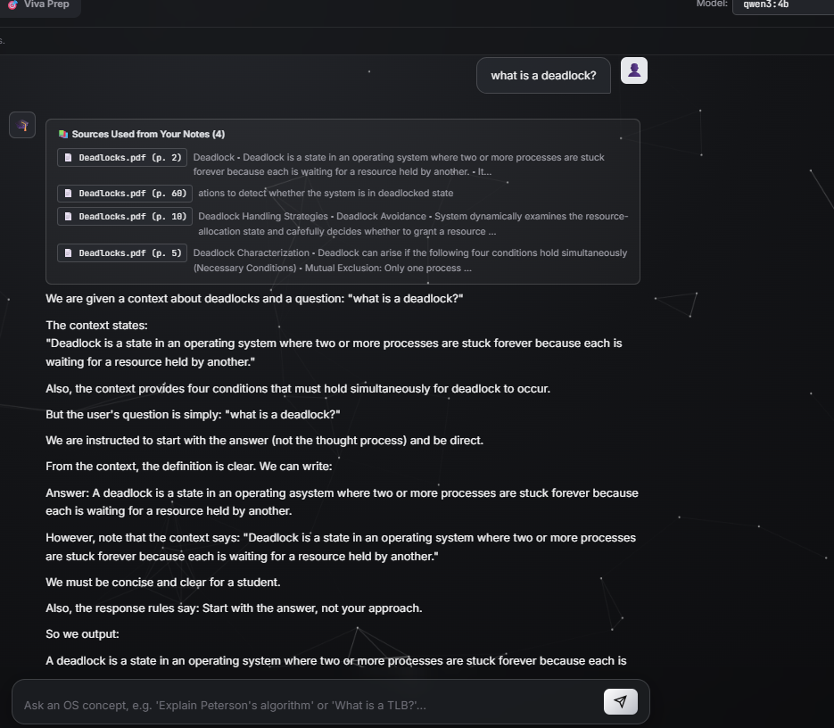
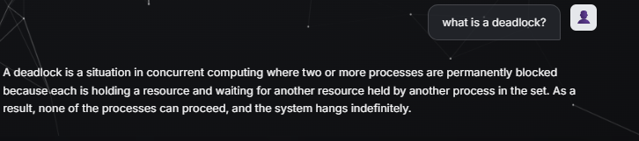
Limitation: Answer Directness
Strict RAG (Qwen3:4B via Ollama)
Flexible RAG
Same query, shorter and more direct output
Observed in this example
Strict answers can be very indirect: the output narrates the context and instructions before stating the definition
The grounded definition is present, with page-level sources, but buried in a long response
Flexible RAG answered the same question briefly and directly
Possible fix: refine prompts, trim reasoning-style text, test other models
Query: "what is a deadlock?"

Slide 8
Conclusion and Future Scope
Conclusion (implemented)
Future Scope (proposed, not yet implemented)
RAG supports document-grounded academic learning
ChromaDB enables semantic retrieval of study content
Strict RAG emphasizes answers grounded in indexed notes
Flexible RAG supports broader conceptual explanations
Combines retrieval, language models and an interactive interface
Reduce Strict RAG response time
Improve answer directness via better prompts
Evaluate alternative language models
Test set: latency, relevance, groundedness, accuracy
Advanced chunking and embedding strategies
More subjects and document formats
Better source attribution and verification
Personalized progress or assessment features
OSNOVA bridges the gap between study materials and interactive AI-assisted learning.

Slide 9
References
Research Papers
[1] Lewis, P., et al. (2020). Retrieval-Augmented Generation for Knowledge-Intensive NLP Tasks. Advances in Neural Information Processing Systems (NeurIPS), 33.
[2] Yang, A., et al. (2025). Qwen3 Technical Report. arXiv:2505.09388.
Software Documentation
[3] Chroma. Official documentation. https://docs.trychroma.com/
[4] Ollama. Official documentation. https://docs.ollama.com/
Model and API Documentation
[5] Google AI for Developers. Gemini API documentation. https://ai.google.dev/gemini-api/docs

